Slide 1
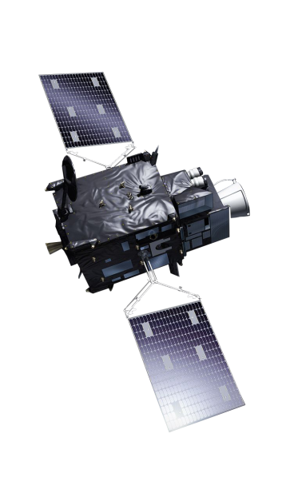
Expert Forum for Preparing MTG Meteorological Applications and Training
CWG Meeting, 6 April 2021,
Ivan Smiljanic, EUMETSAT

Slide 2
MTG Forum
Why is the Forum?
Who is the Forum?
Modus operadni
Timeline
Examples

Slide 3
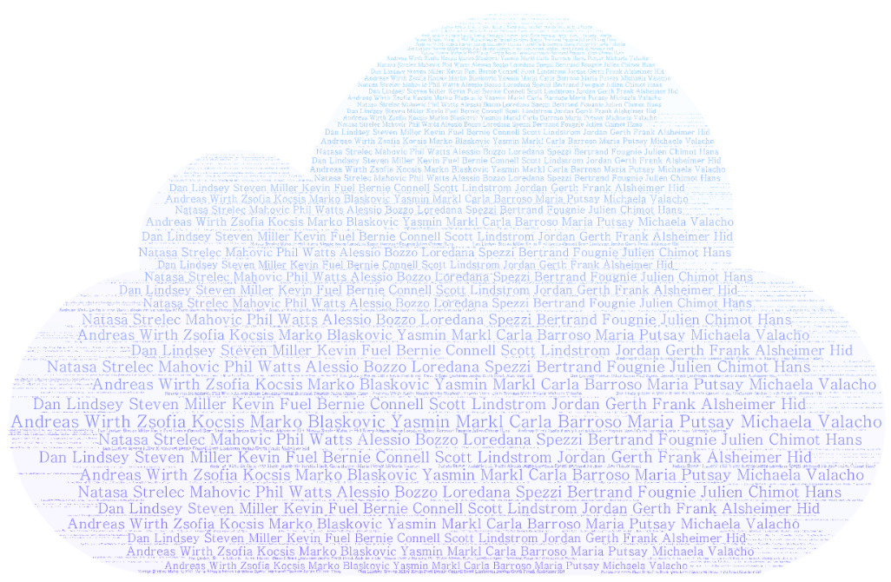
Who is the Forum?

Slide 4
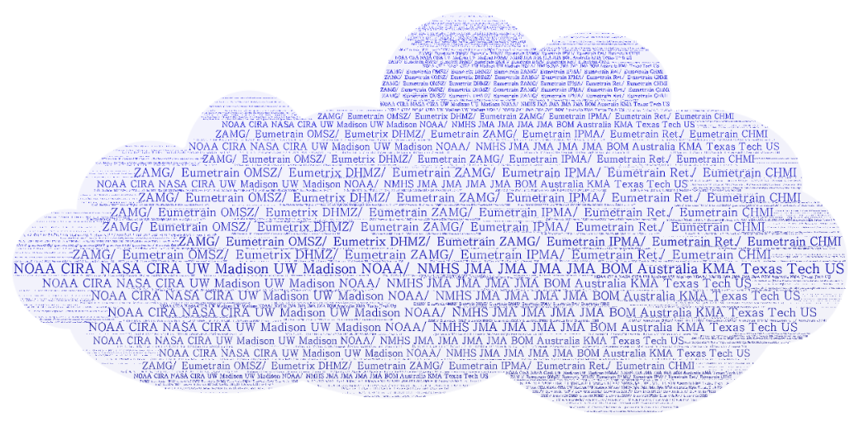
Who is the Forum?

Slide 5
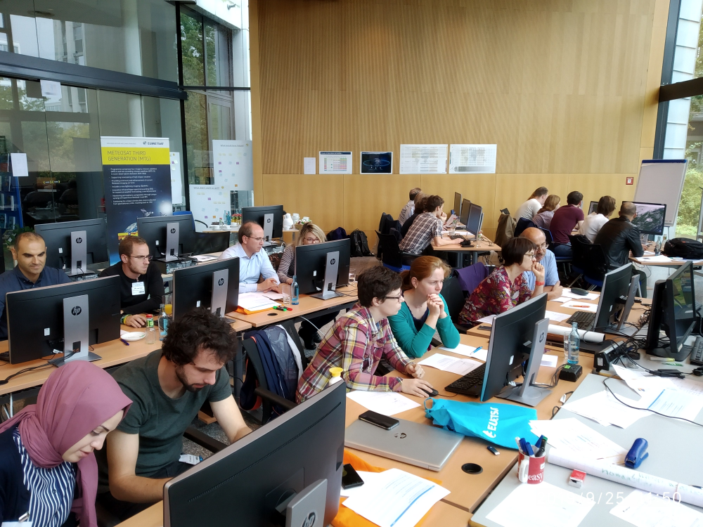
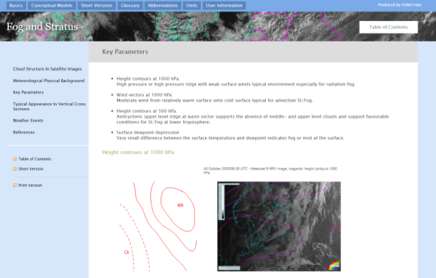
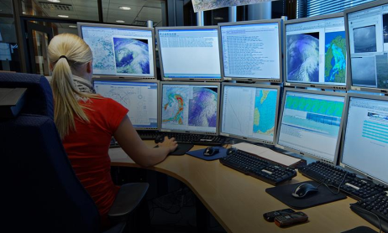
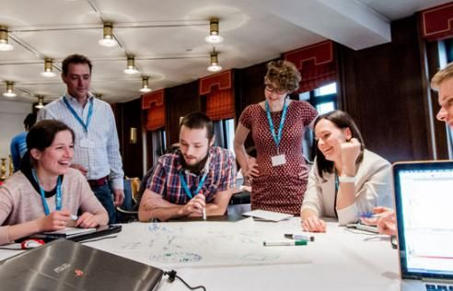
Why is the Forum?
MTG Training
MTG Application guide
MTG utility
NMHSs
SME Network

Slide 6
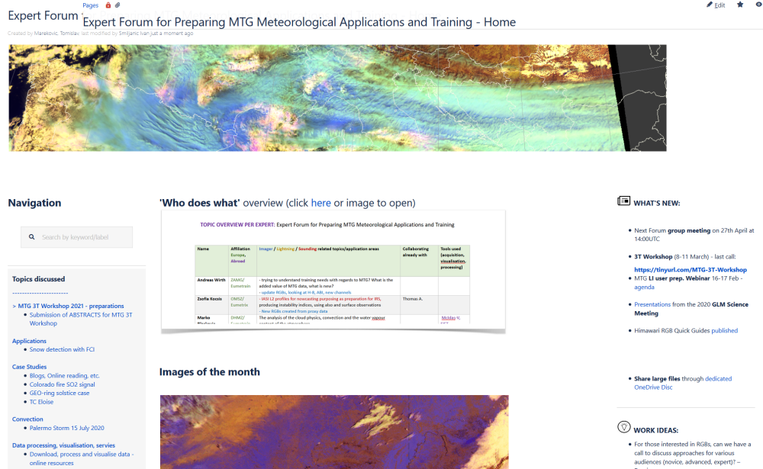
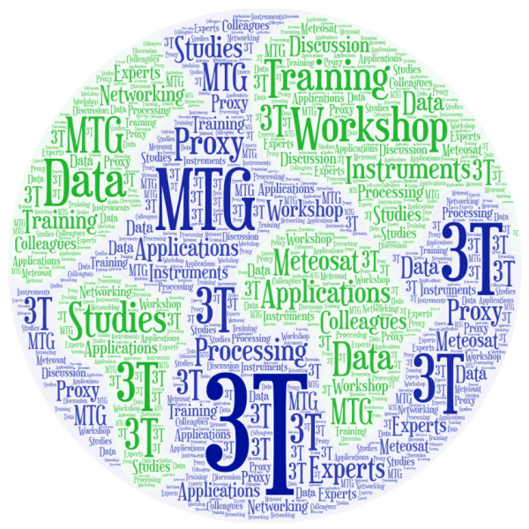
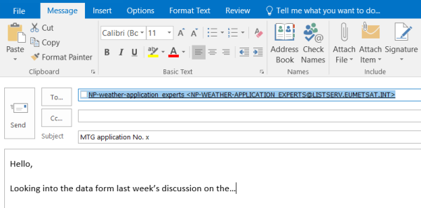
Modus Operandi
Exchange Platform
Monthly discussions
‘3T’ Workshop
Email
exchange

Slide 7
Timeline
KO
Meeting
(May 2020)
Monthly discussions
(2020/21)
3T Workshop
(Mar 2021)
Monthly discussions
(2021/22)
3T Workshop
(Mar 2022)
…
(2023+)

Slide 8
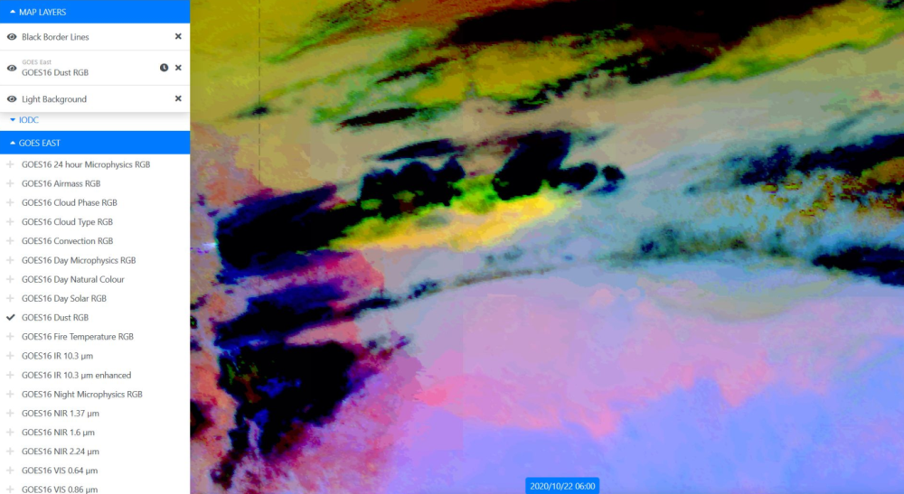
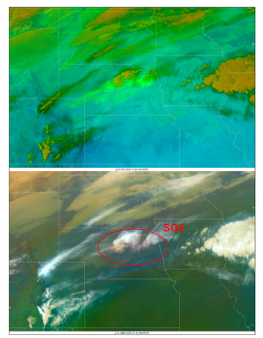
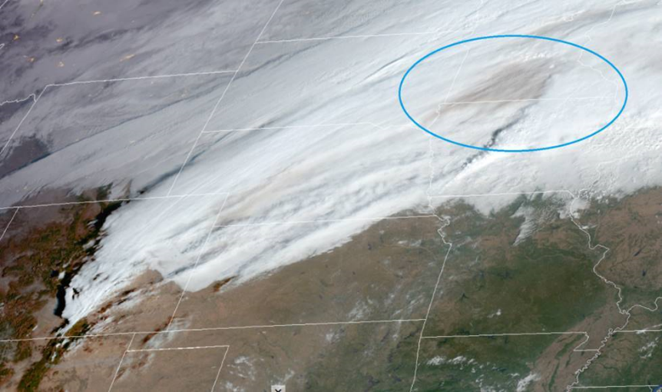
Examples: Colorado fire SO2 and ash signal
By: HP Roesli, Julien Chimot, Dan Lindsey, Ivan Smiljanic

Slide 9
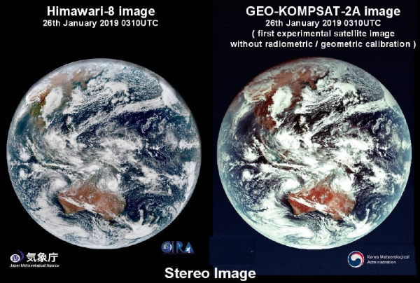
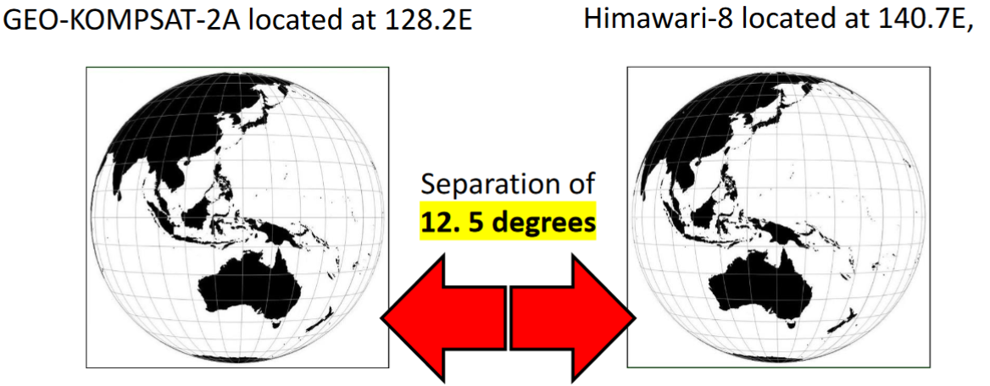
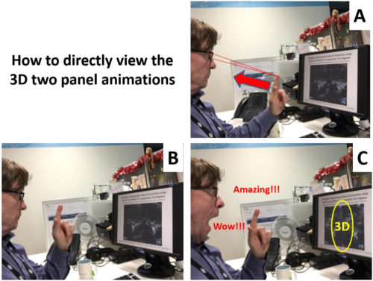
Examples: Stereoscopic 3D imagery
By: Bodo Zeschke, Jan Kanak

Slide 10
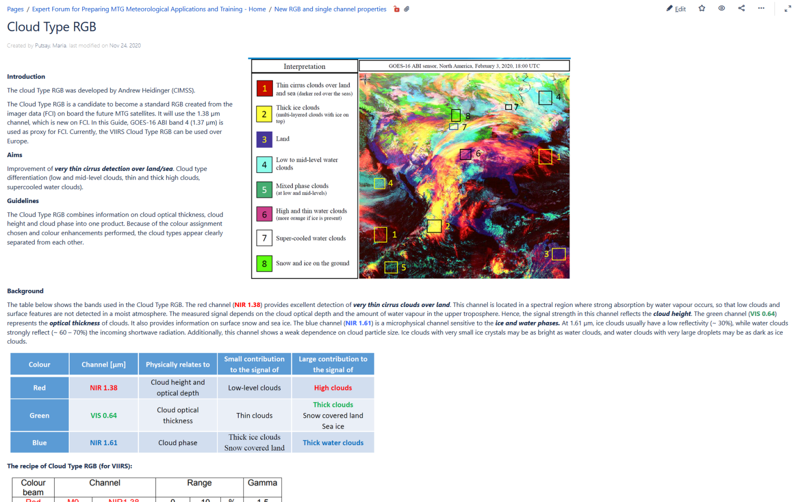
Examples: New channels/RGBs/Products
By: Maria Putsay

Slide 11
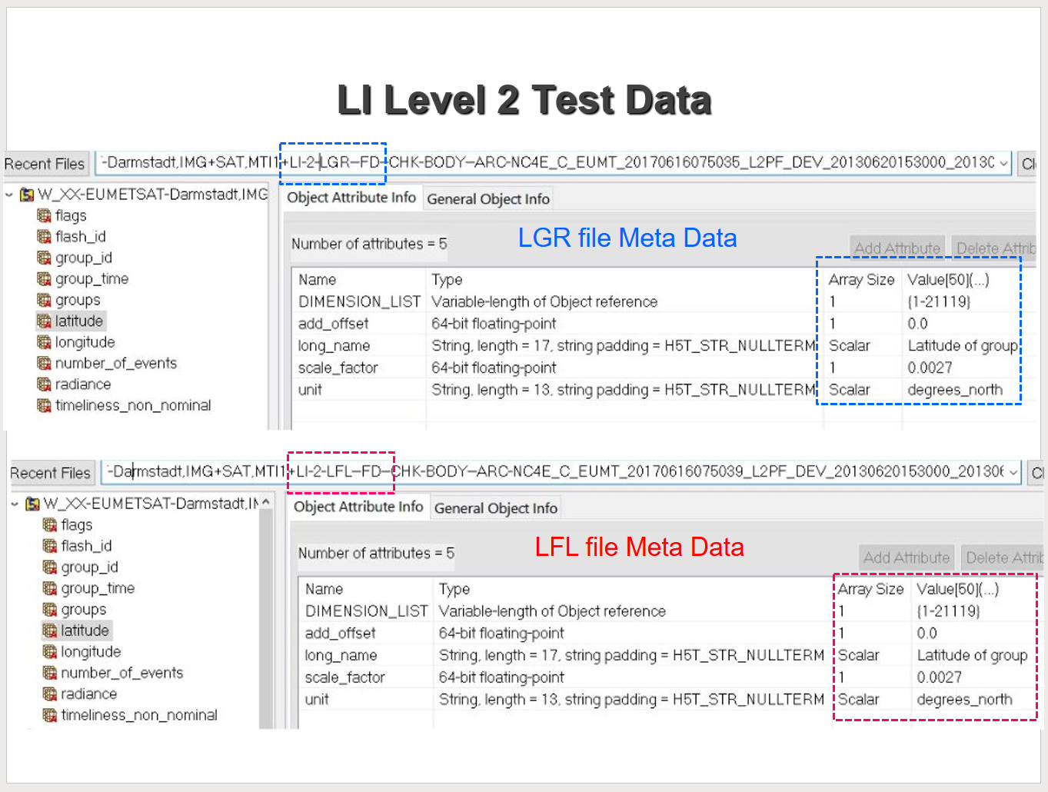
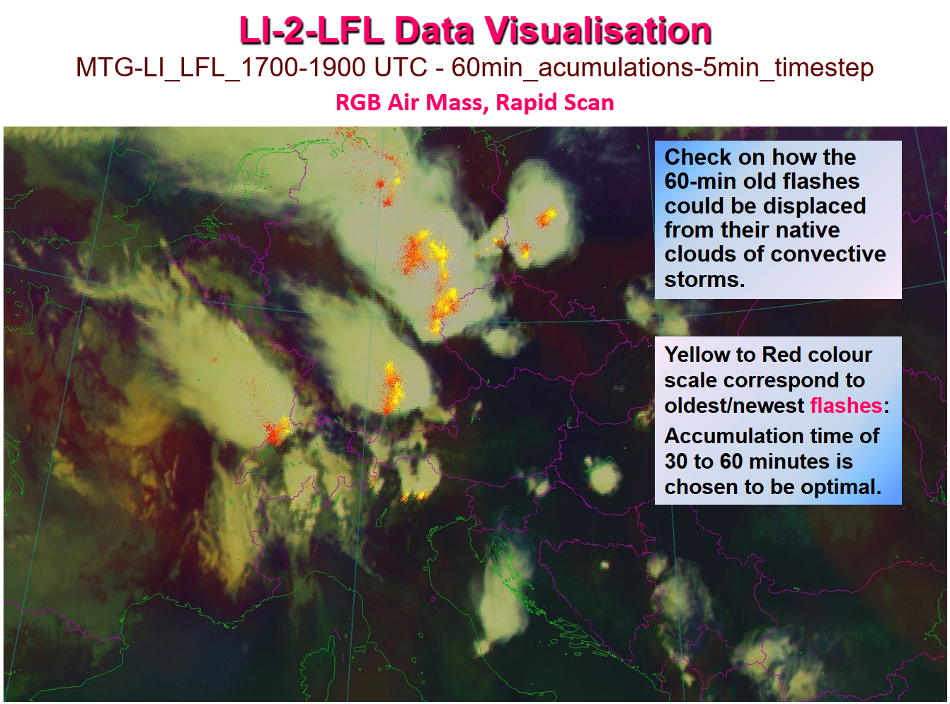
Examples: Test data processing and visualization
By: Christo Georgiev, Jan Kanak, Andrey Kulishev, Luboslav Okon

Slide 12
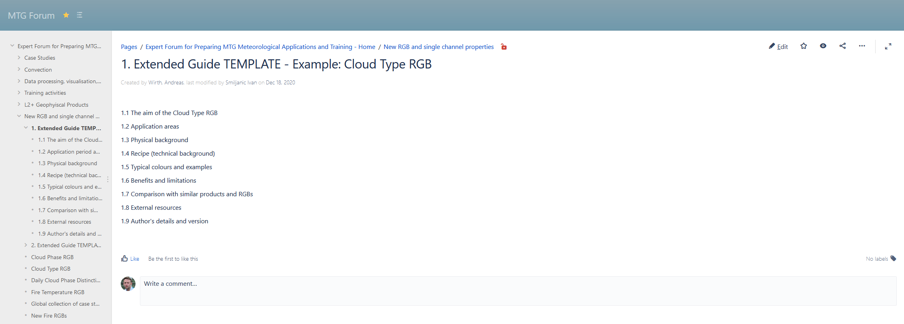
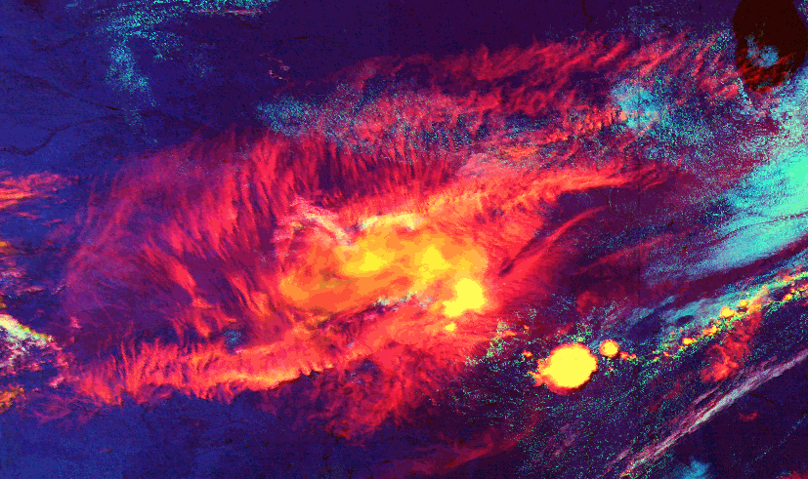
Examples: Training items
By: Andreas Wirth, Marko Blaskovic

Slide 13
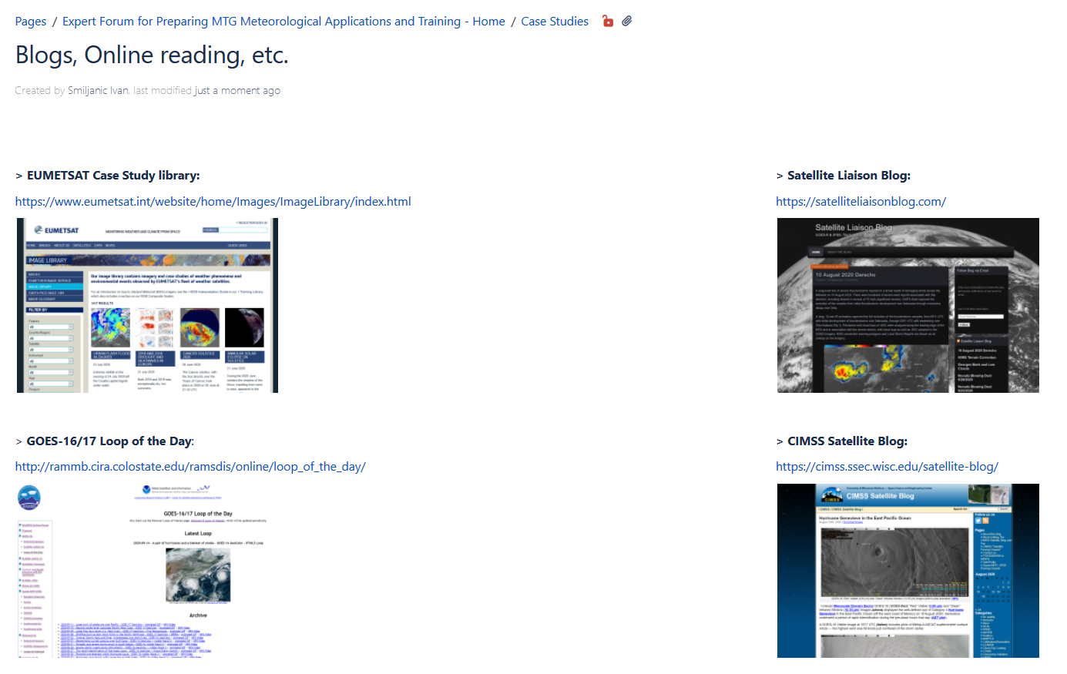
Examples: Useful info
By: All

Slide 14
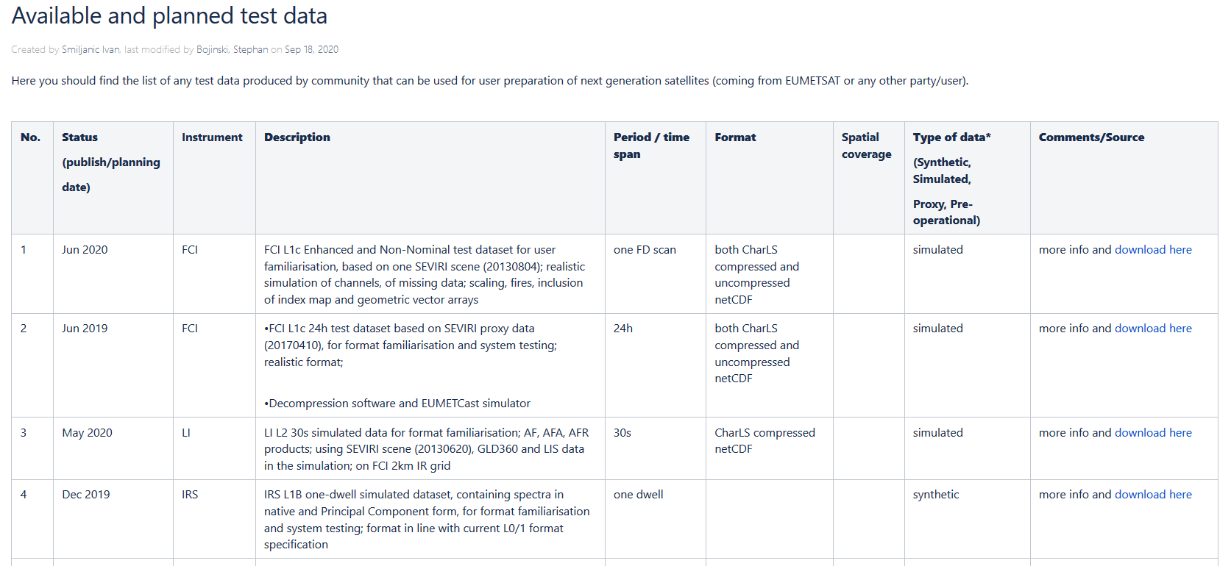
Examples: Useful info
By: All

Slide 15
Welcome

Slide 16
3T agenda
Agenda: MTG 3T Forum (8-11 March 2021)
Time (UTC) | Monday, 8th March APPLICATIONS 1 | Tuesday, 9th March APPLICATIONS 2 | Wednesday, 10th March PRODUCTS and DATA PROCESSING Only on Wednesday we start at 12:00 UTC! | Thursday, 11th March RGBs, PREPARATION PLANS
13:00-13:45 | Welcome and Introduction | Christo Georgiev, NIMH: MTG Lightning Imager Simulated Level 2 products: experience in Test Data processing and visualization | (12:00 UTC) Jan Kanak, SHMU: Investigation of possibilities of dual satellite observations with new generation of geostationary satellites | Akihiro SHIMIZU, JMA: Himawari RGB Quick Guides and examples of novel RGBs
13:45-14:30 | HansPeter Roesli, Switzerland: Capabilities of FCI band NIR0.914 to explore moisture fields in the lower troposphere | Jos de Laat, KNMI: Lightning data applications at KNMI | (12:45 UTC) >>> MTG Forum Group – colleagues | Maria Putsay, OMSZ: Colour contrasts seen on RGB images – What do they depend on? – Experiences
14:30-15:15 | Steve Goodman, NOAA: High Impact Weather in the Lake Victoria Basin (LVB) – Implications for MTG | Jean-Marc Moisselin, Sylvain Le Moal, Météo-France: Lightning data valorisation for forecasters and nowcasting | (13:30 UTC) >>> MTG Forum Group – colleagues | Natasa Strelec Mahovic, Stephan Bojinski, EUMETSAT: RGB Workshop, Plans for user preparation, Training in the MTG era
15:15-15:45 | 30min stretch-legs break
15:45-16:30 | Martin Setvak, CHMI: Thin cirrus in the 1.38 µm band and its visualization by histogram equalization method | John Mecikalski, University of Alabama: Topics in Convective Storm Updrafts using GOES-16 Data | (14:45 UTC) Jussi Leinonen and Ulrich Hamann, MeteoSwiss: Evaluating MTG benefits in thunderstorm nowcasting based on machine learning | Andreas Wirth, ZAMG and Marko Blaskovic, DHMZ: MTG training material & training design
16:30-17:15 | -Ivan Smiljanic, EUMETSAT: IR (night-time) detection of Above Anvil Cirrus Plumes and associated ‘Temperature Dipoles’ | Michael Fromm, US Naval Research Lab: Event monitoring, pyroCb, Dust Infused Baroclinic Cyclone | (15:30 UTC) Xavier Calbet and Miguel Angel Martine, AEMET: Detection of spatial variability in geostationary imagers and its potential use and presentation of scientifically realistic synthetic MTG-FCI and MTG-IRS data | Dan Lindsey, NOAA: NOAA's Future Geostationary Satellite Plans
17:15-18:00 | Kristopher Bedka, NASA Langley Research Center: GOES-16, MSG, ABI, SEVIRI, GLM, convection, severe storms, weather, climate | Jean-Baptiste Hernandez, Météo-France: A daytime VIIRS RGB pseudo composite for snow detection | (16:15 UTC) Ralph Petersen, CIMSS: A Multi-satellite Platform Approach to providing Short-term Guidance of Significant Weather Potential | Final discussion and Workshop closing

